Slide 1
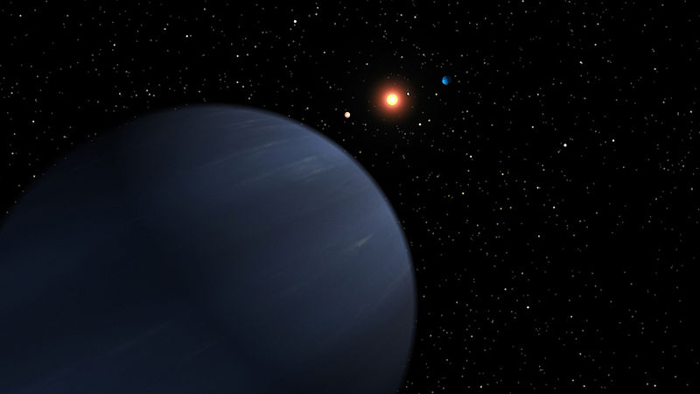
A non-dissipative tidal evolution of stellar inclination axis in eccentric inclined close binary systems
Pavel Ivanov, Lebedev Physical Institute

Slide 2
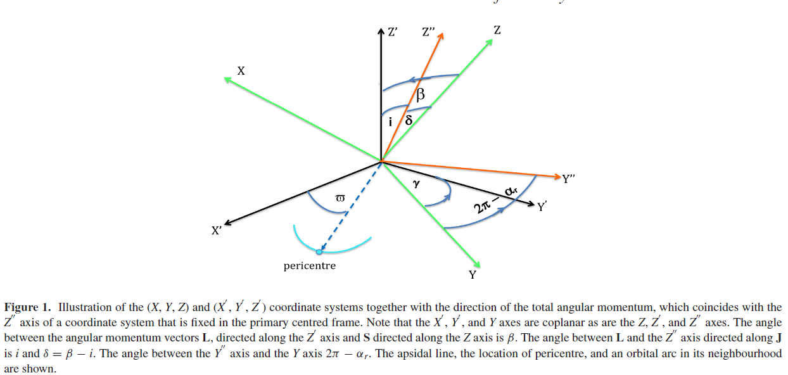
Coordinate systems used below

Slide 3

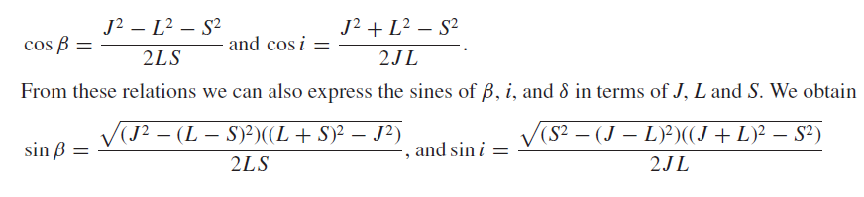

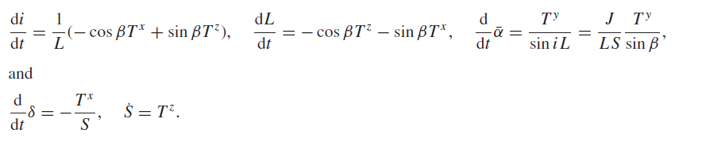

General equations following from the law of conservation
of angular momentum and definitions of the inclination angles

Slide 4




Transfer rates of energy and angular momentum due tides
U is the tidal potential, in the orbital frame it has the form

Slide 5
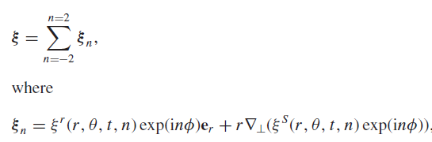



An outline of derivation of the evolution equations
is a particular harmonics in Fourier decomposion in time of

Slide 6



The evolution equations
They contain

Slide 7

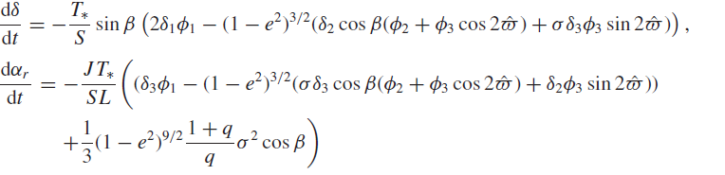


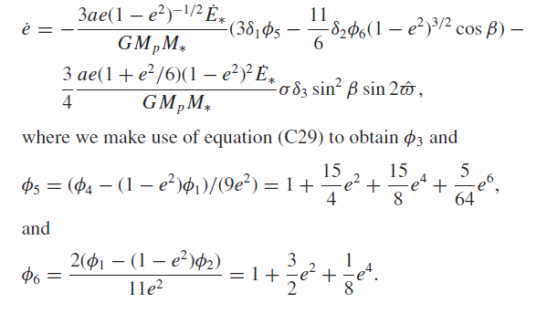

Slide 8


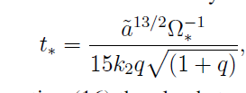
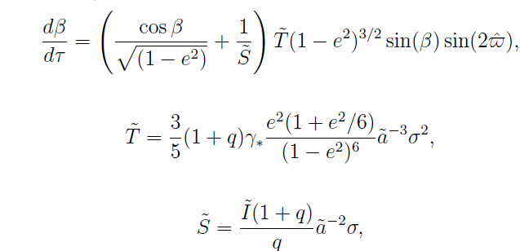
The evolution caused by only 'rotational' terms
Let's do retain only the terms proportional to
In this case energy is conserved, but inclination and rotational angles evolve
as well as eccentricity. The evolution depend on a law of change of the apsidal
angle. It is thus very important to establish all factor, which may cause the
apsidal precession. Also note that in the case of non-dissipative evolution
there are two integrals of motion. At first, the primary spin, S, is conserved.
Secondly, it may be shown that the following quantity is also conserved.

Slide 9
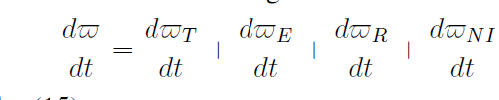
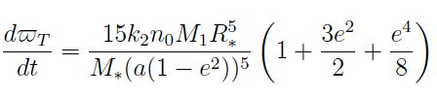

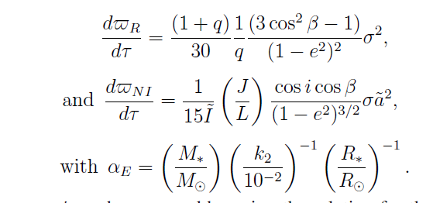
All major conributions to the apsidal precession rate in case of an isolated binary
In general, we have

Slide 10



The evolution of the system depends significantly on whether or not it is close to some 'critical curve' defined
by the condition that
at
Let us first assume that the system is away from such a curve
in the course of its evolution. In this case the evolution is dominated by a single term in the equation of apsidal motion. When stellar rotation is slow these terms are the tidal and Einstein ones, and the latter dominates when
where tilde a is the orbital semi-major axis expressed in units of
stellar radius.

Slide 11

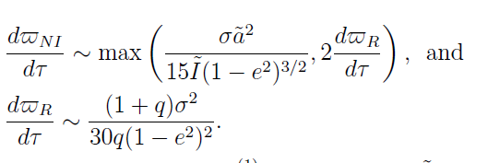
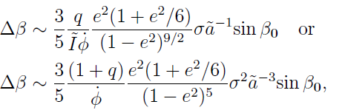
To estimate the importance of the rotational and non-inertial terms
we set
to have
In general the time derivative of beta can be estimated as
where
is the largest time derivative of the apsidal and the first
expression is used when the spin angular momentum is smaller
than the orbital one or vice versa.

Slide 12
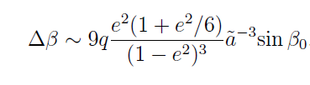
It turns out that in the rotational regime the variation of the inclination
angle is independent on the relative significance of the spin and
orbital angular momenta. The corresponding expression provides
the maximal value of variation in case when other parameters of
the system are fixed

Slide 13


Critical curves are defined by the condition
An analysis of the corresponding algebraic equation shows that
for prograde rotations the critical curves exist only when initial
inclination is sufficiently large, and it is larger than
For retrograde rotations there exist a possibility to have two solutions
(branches) for a given σ, while in the prograde case there is only
one branch

Slide 14
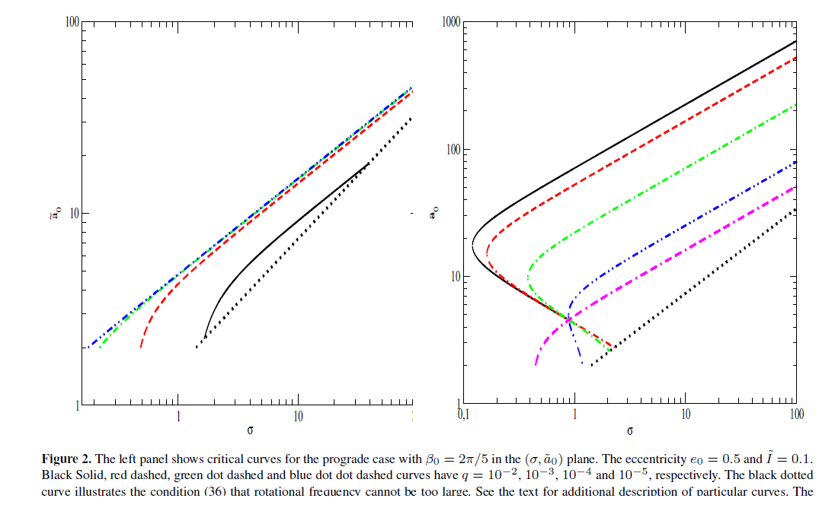

Slide 15
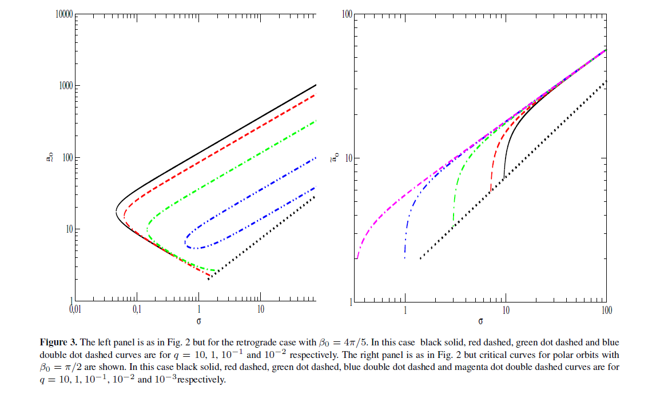

Slide 16

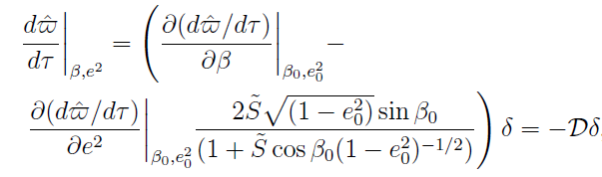


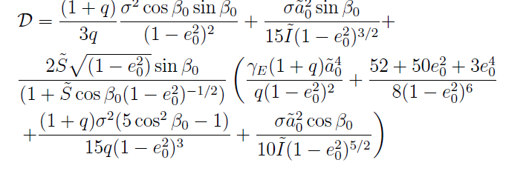

Assume that
is small.
Then

Slide 17
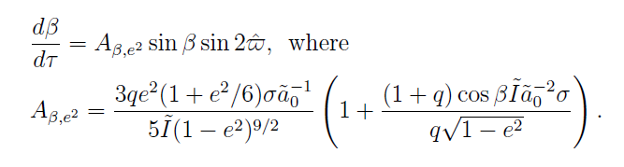

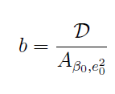






Slide 18
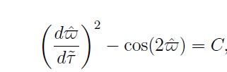

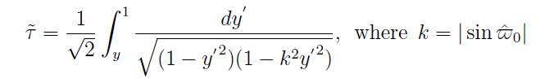
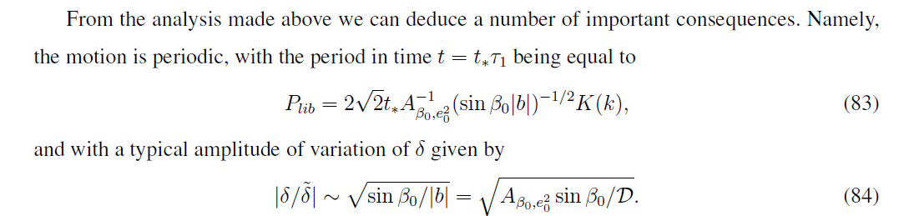

Slide 19
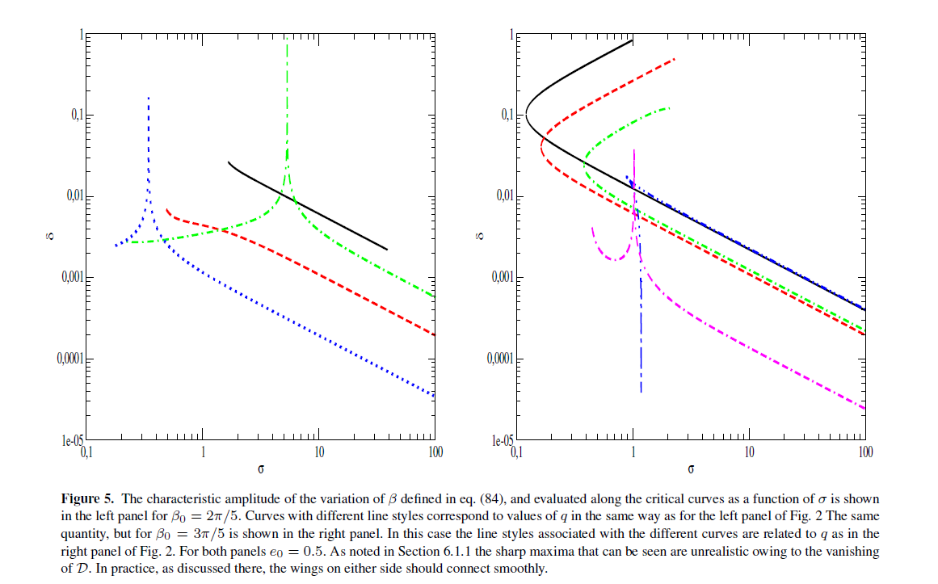

Slide 20
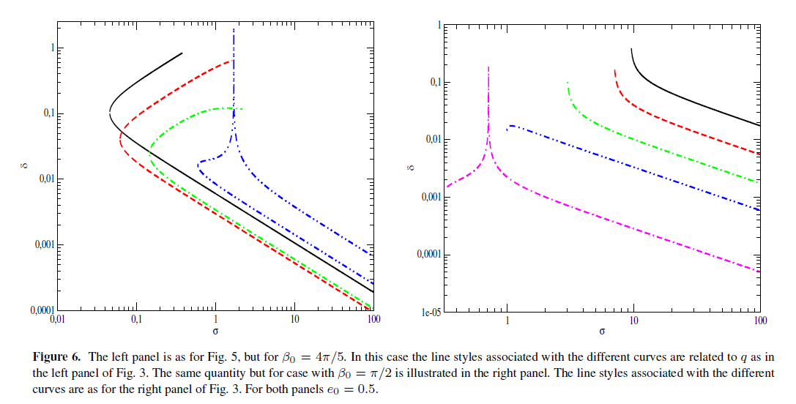

Slide 21
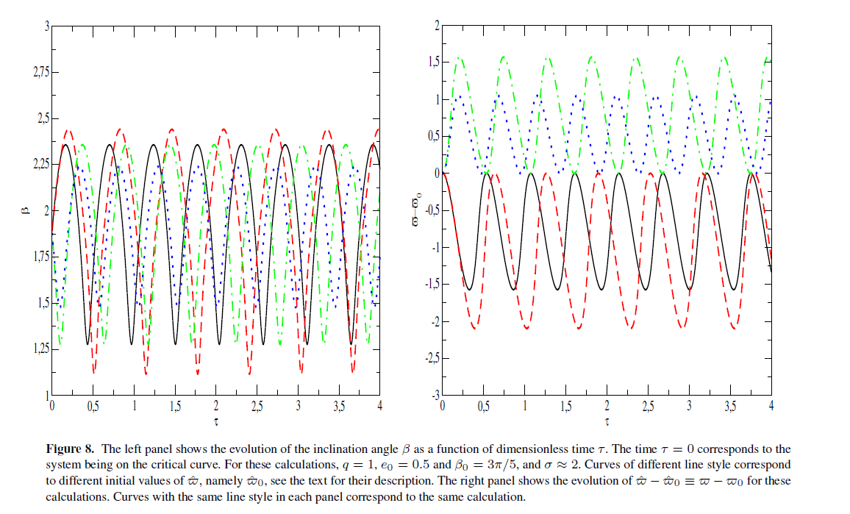

Slide 22
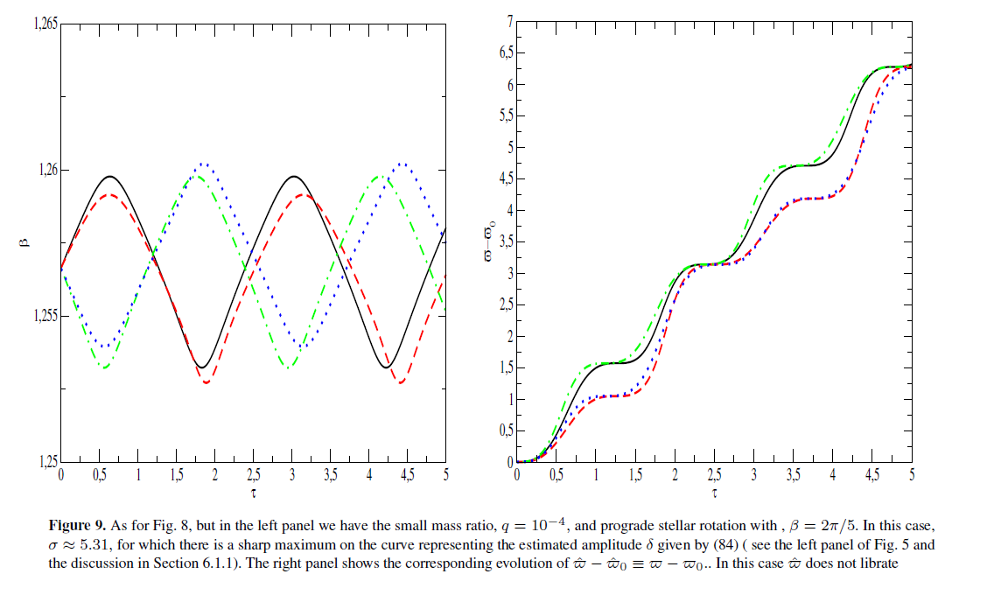

Slide 23
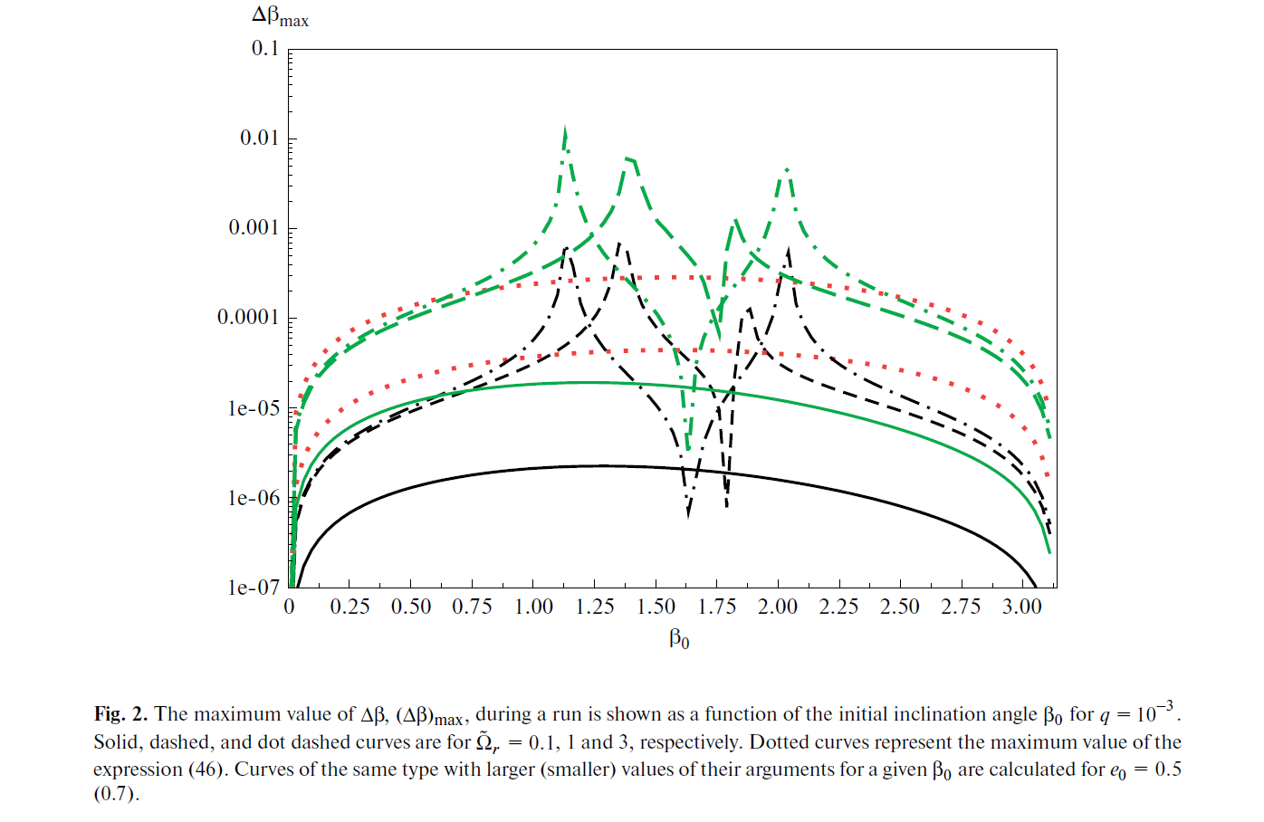

Slide 24
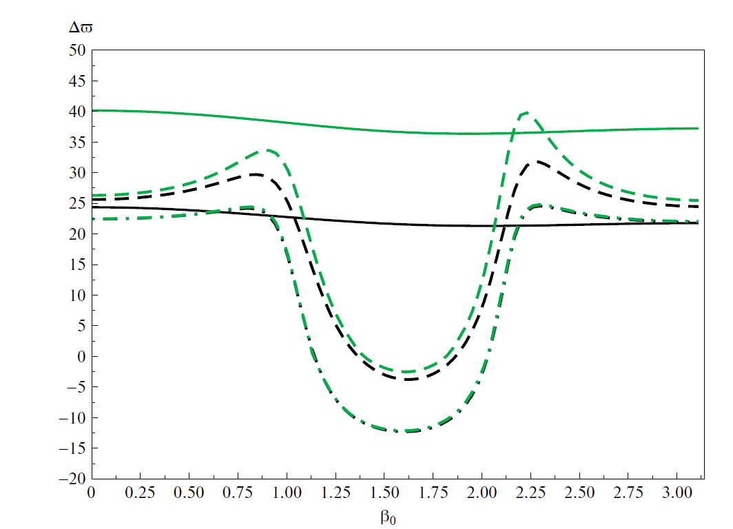

Slide 25
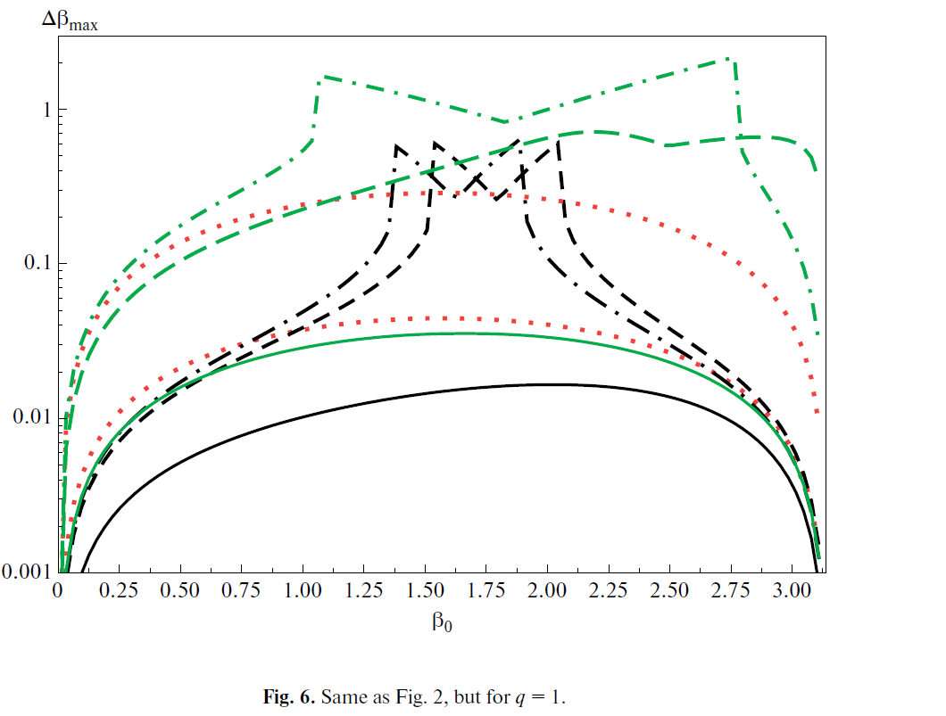

Slide 26
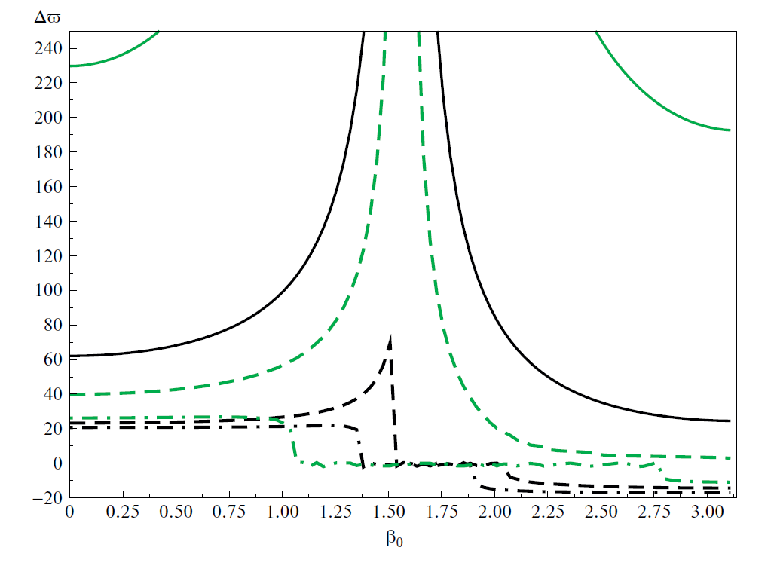

Slide 27
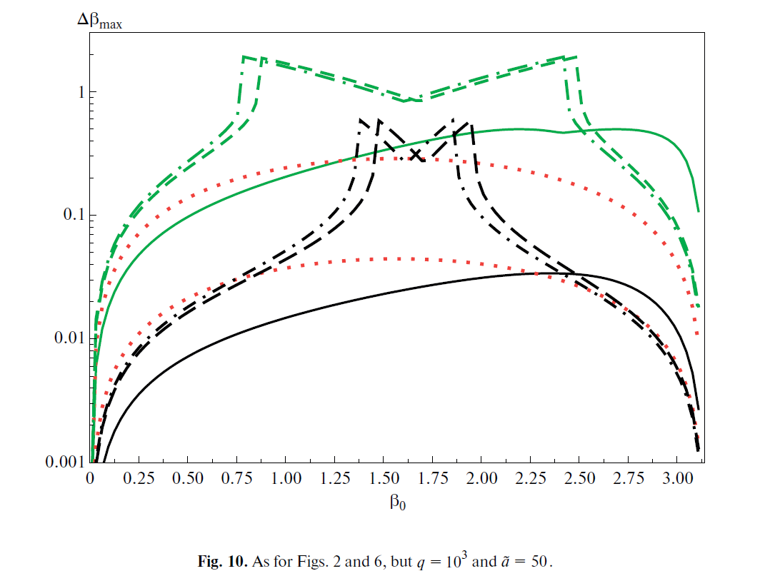

Slide 28
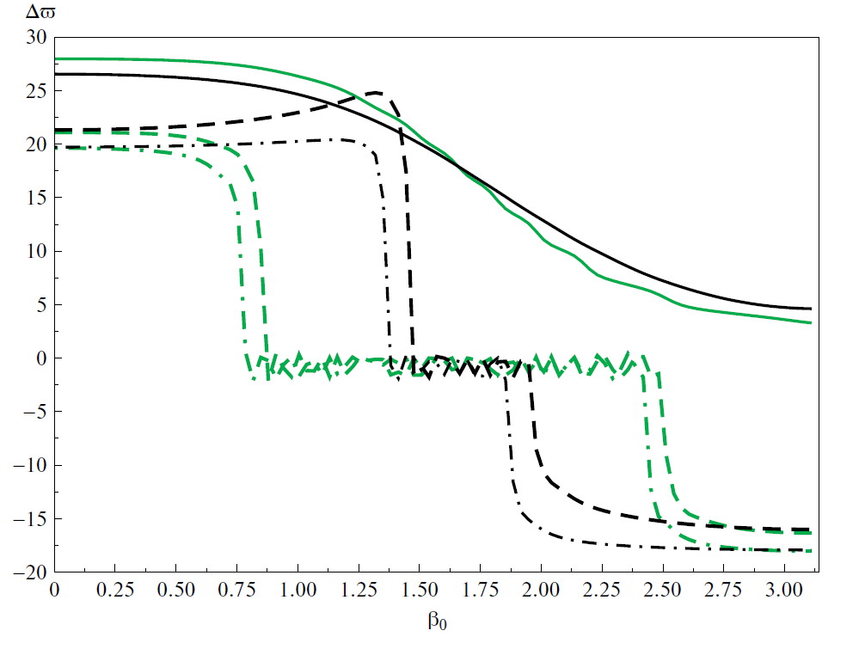

Slide 29
CONCLUSIONS
The joint evolution of stellar rotational axis and the apsidal line allows for a
rather non-trivial dynamics in case of inclined systems with orbital parameters, such that the system happens to be close to the critical curve.
Contrary to the usual evolution, there is a possibility to have librations of the
apsidal line. This effect is significant for the systems with either a comparable
mass ratio, or the systems, where the mass ratio is large. For example, in
principle, this effect can be used to determine the state of rotation of an exoplanet (say, a warm Jupiter) orbiting its host star on an inclined eccentric
orbit. It also can play a role in systems with compact objects and binary stars
with anomalous precession rate of the apsidal line.
It is very important to generalise the results to the case of two tidally interacting
stars (work in progress). It is also very important to check, whether or not this effect can be observed in the present time in systems with realistic parameters.

